Slide 1
Lung Cancer Prediction
THIRUPPATHI D (B.E) -CSE

Slide 2

Overview of Lung Cancer:
Leading cause of cancer death worldwide
1.59 million deaths in 2018
Problem Statement:
High mortality rate
Smoking and air pollution as risk factors
Recent Study Findings:
Link between air pollution and lung cancer, even in non-smokers.

Slide 3
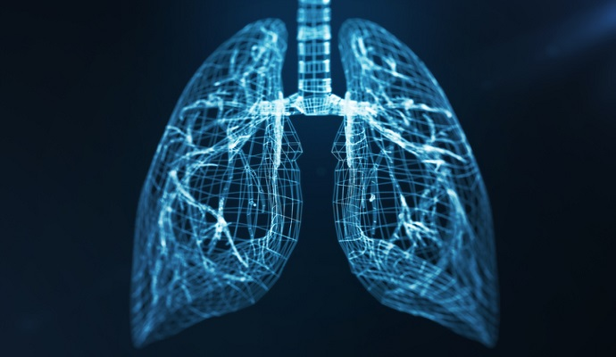

OBJECTIVE
OBJECTIVE:
Develop a machine learning model for early detection of lung cancer based on patient data.
Explore risk factors and improve understanding of the disease.

Slide 4
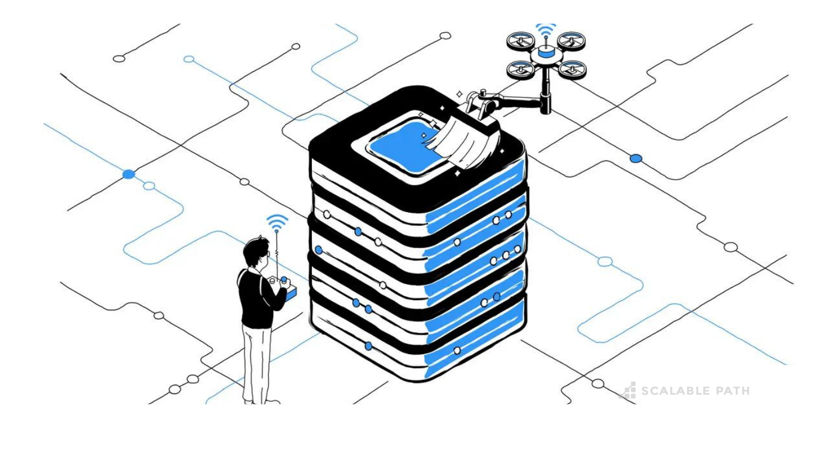
Collection of Dataset:
Patient data with various features
Size of Dataset:
1000 Unique Data
Number of Column 25
Pre-processing of Data:
Remove The Unwanted Data.

Slide 5
Model Block Diagram
Weighted Feature
Data Cleaning
Survey Data
Training Data
Testing Data
Activation -Sequential
Lunge Cancer Prediction

Slide 6
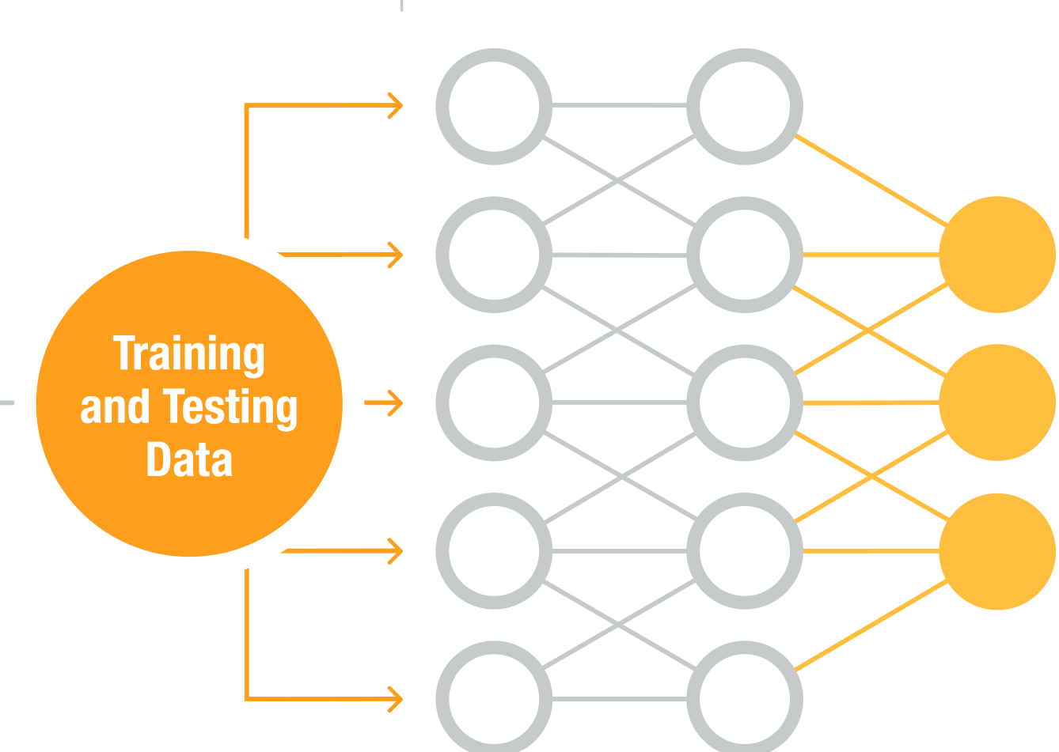
Ratio of Traning &Testing
80% of the data is Training
20% of the data is Testing.
Neural Network Architecture:
Sequential Model:
A linear stack of layers.
Dense Layers:
Fully connected layers with 100 units each.
Activation Functions:
'ReLU' (Rectified Linear Unit) activation for hidden layers.
'Linear' activation for the output layer.

Slide 7
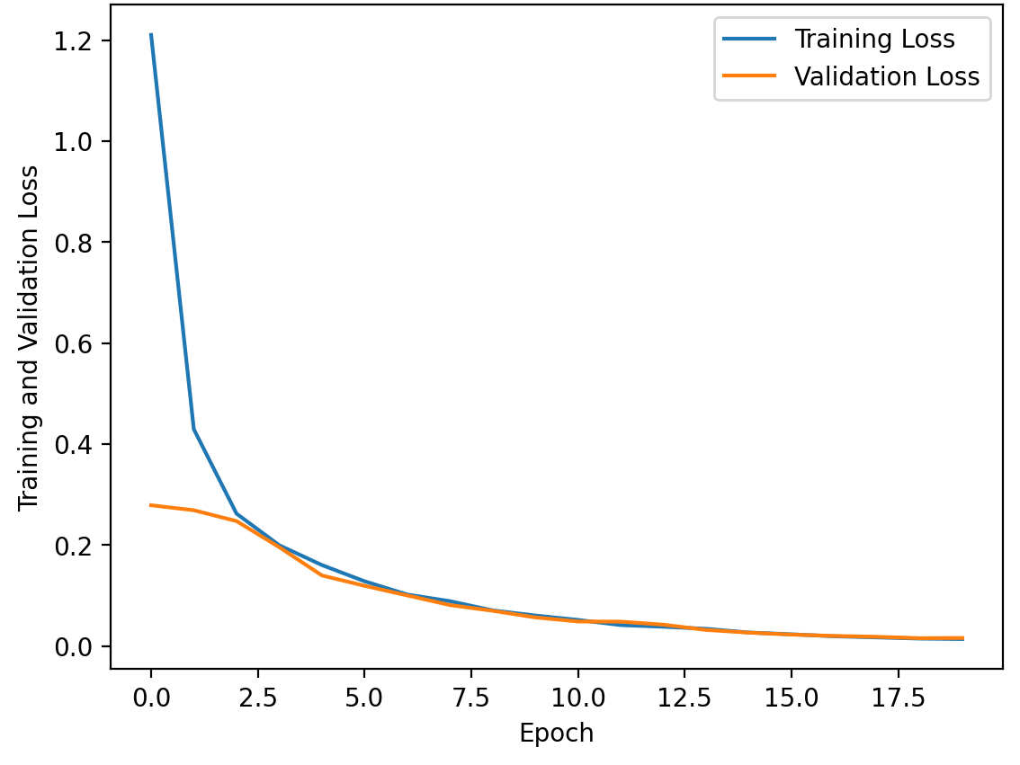
Model Loss Progress During Training

Slide 8

Model Evaluation Metrics
Root Mean Squared Error (RMSE):
Provides the average magnitude of the errors between predicted and actual values.
RMSE = 0.123.
Adjusted R-squared:
Adjusts R2 based on the number of predictors to provide a more accurate measure.
Adjusted R2 = 0.975.

Slide 9
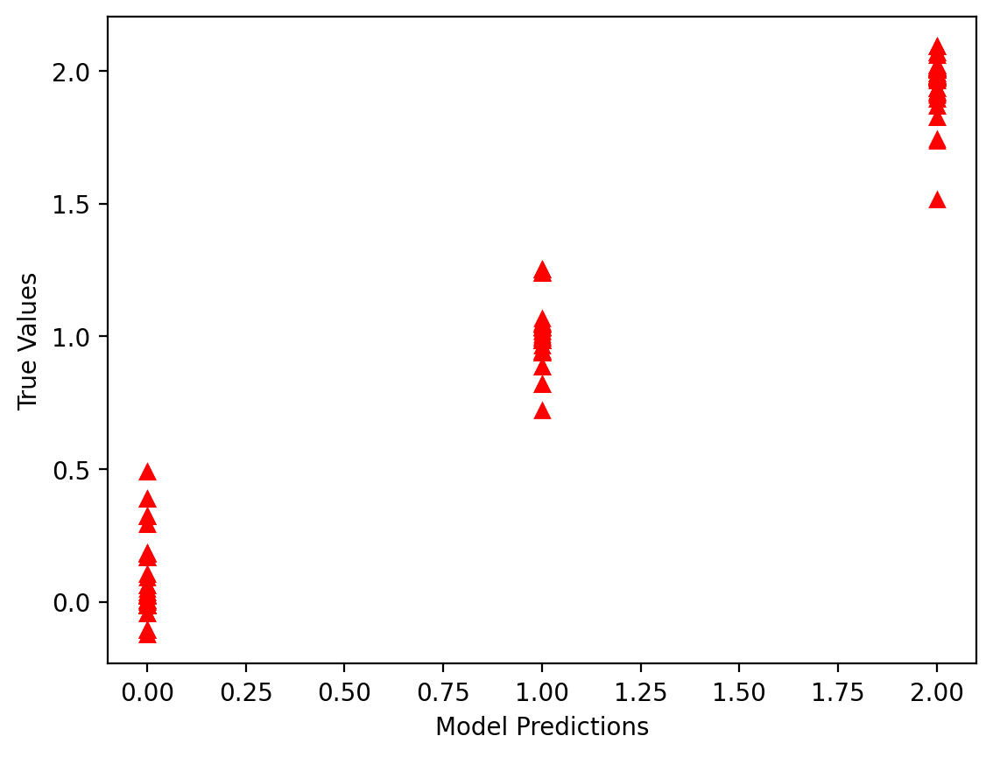
Predicted Output Digaram

Slide 10
Thank You

